Slide 1

BUDGET 2025 – 26 ANALYSIS
For UPSC CSE 2026
By Khushboo
Economics Faculty

Slide 2
This year budget aims to achieve...
Revive Economy and boost GDP by boosting consumption
GDP = C + I + G + (X-M)
Achieve 4.5 % Fiscal Deficit by the end of FY2025 – 26

Slide 3
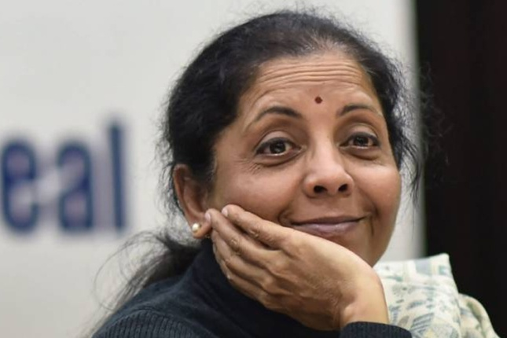

To REVIVE ECONOMY
Govt – Fiscal policy
  RBI - Monetary policy

Slide 4
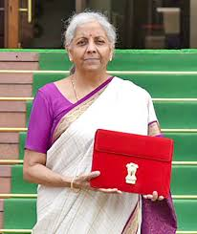
BUDGET
Budget is an Annual Financial Statement containing estimated revenues and expenditures for the next financial year. Budget is the primary tool used by Govt to implement its fiscal policy.
The term ‘budget’ is NOT mentioned anywhere in the constitution. Instead it is mentioned as Annual Financial Statement in Article 112
A fiscal year starts from April & ends in March
Budget is presented on Feb 1 every year for an upcoming fiscal year (from Apr to March) while Economic Survey is released on Jan 31 to denote the performance of Indian economy in previous year (from Jan to Dec)

Slide 5
BUDGET
Article 112 to 117 of constitution relates to financial matters
Article 112 – Annual Financial Statement
Article 116 – Vote on Account
Article 266 – Govt CAN’T withdraw money from Consolidated Fund of India WITHOUT Parliament’s approval (except for Charged Expenditure like Judges’ salaries etc)

Slide 6
BUDGET
Along with budget, govt should lay FOUR documents before the Parliament. They are
Macro Economic Framework Statement
Medium Term Expenditure Framework
Medium Term Fiscal Policy Statement
Fiscal Policy Strategy Statement

Slide 7
6 Stages of Budget Presentation
1. PRESENTATION OF BUDGET
Finance Minister Speech in Both houses
2. GENERAL DISCUSSION
Both houses
3-4 days
3. SCRUTINY BY DRSCs
3-4 weeks
4. VOTING FOR DEMAND OF GRANTS (only for MADE EXPENDITURE)
Only Lok Sabha
Has Cut Motion
5. APPROPRIATION BILL (for Both MADE + CHARGED EXPENDITURE)
6. PASSING FINANCE BILL
Money withdrawn from Consolidated Fund of India
Tax provisions (For Income side of the Govt)
No cut motion
Lok Sabha (upper hand)

Slide 8
6 Stages of Budget Presentation
The finance bill and appropriation bill are considered money bills under article 110 Therefore Rajya Sabha (RS) approval is not necessary.
Money bills can only be introduced by Ministers. That too only in Lok Sabha
At maximum, the Rajya Sabha can discuss it for 14 days and give suggestions to Lok Sabha for amendments, but it’s not binding on the Lok Sabha to accept Rajya Sabha’s suggestions.
The whole process of passing the budget may take upto 75 days

Slide 9
Vote on Account Vs Interim Budget
Vote on Account
Interim Budget
Article 116 of constitution
Passed for 2 months expenditure (April, May) when there was a delay in passing the budget, esp before 2017 budgets
Contain only Expenditure component
Currently not used since the whole process is aligned with fiscal year
Not mentioned in constitution
Passed only during election year to prevent manipulation of voting behaviour by ruling party
Contain both Revenue & Expenditure component
Used in 2024

Slide 10
Components of Budget
BUDGET
Revenue Budget
Revenue Receipt
Revenue Expenditure
Capital Budget
Capital Receipt
Capital Expenditure
Tax
Non Tax
Direct Tax
Indirect Tax
Debt creating
Non - Debt Creating

Slide 11
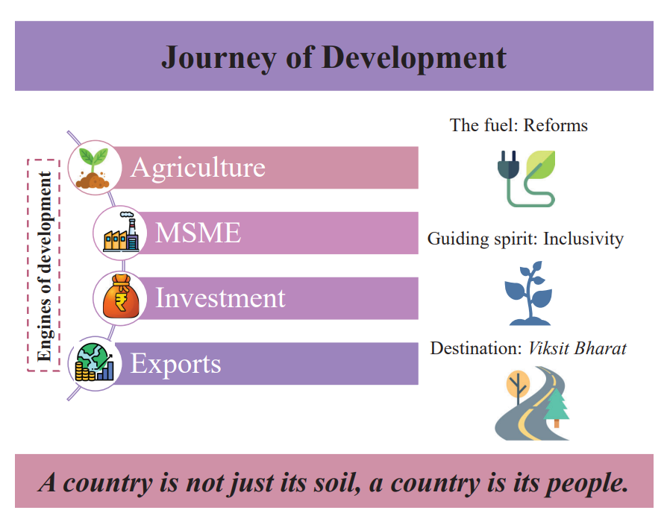
BUDGET 2025 – 26 Proposals

Slide 12

Guiding Spirit : Inclusivity

Slide 13
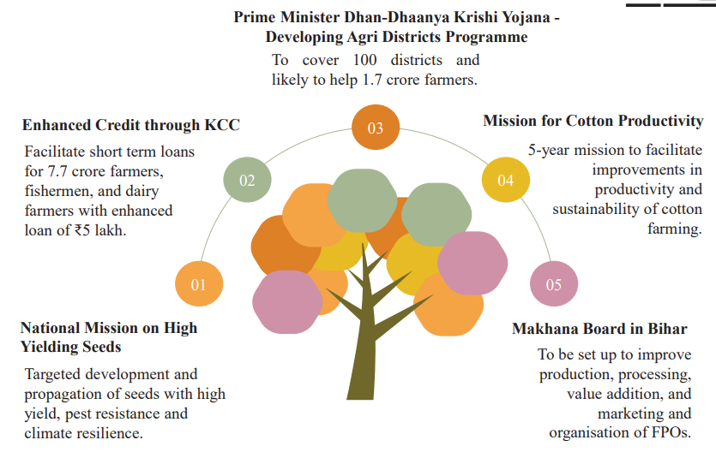
1st Engine of Development - AGRICULTURE

Slide 14
Makhana Board in Bihar
Water lily seed / fox nuts / lotus seed
90 % of total world production – in Bihar
Bihar – largest exporter in the world
Superfood – High protein, rich in K, Fe, Ca, low carbs & fats, low glycemic index

Slide 15
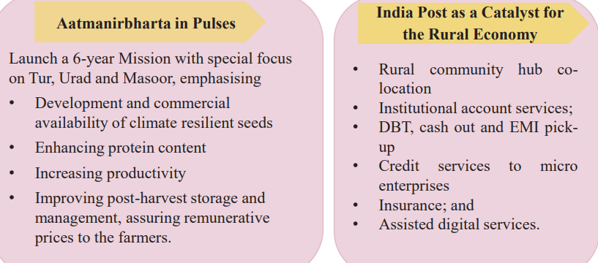
AGRICULTURE

Slide 16
Aatmanirbharta in Pulses
India – No. 1 in Production, consumption, export and also import
Despite being largest producer, we still have to import to meet demands
Hence need Aatmanirbharta in Pulse production esp Tur, Urad and Masoor

Slide 17
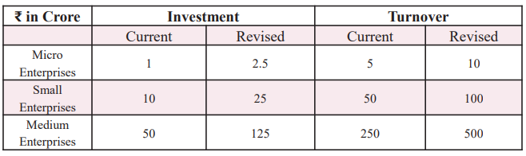
2nd Engine of Development - MSME

Slide 18
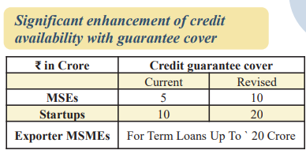
MSME – Micro, Small & Medium Enterprises

Slide 19
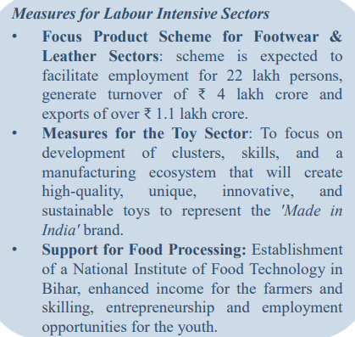
MSME

Slide 20
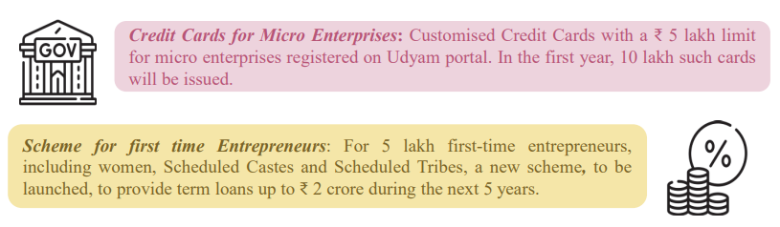
MSME

Slide 21
3rd Engine of Development - INVESTMENT
Investment in
People
Economy &
Innovation

Slide 22
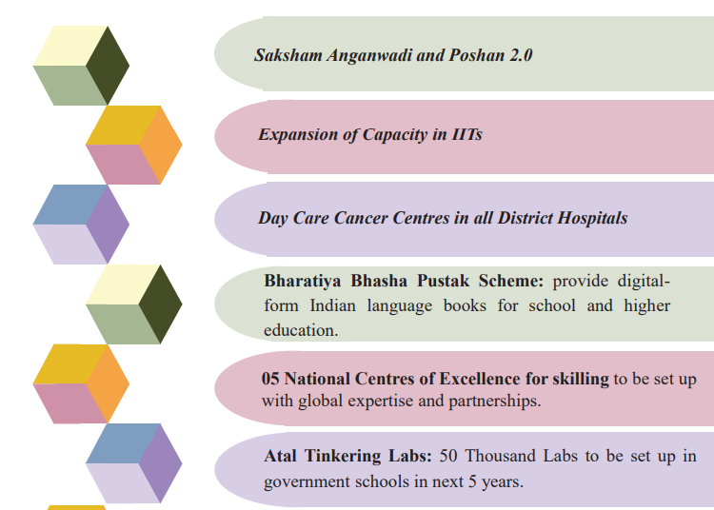
Investment in PEOPLE

Slide 23
Saksham Anganwadi & Poshan 2.0
Nutritional support to
Children
Pregnant & lactating women
Adolescent girls
In 2.0, budget amount increased

Slide 24
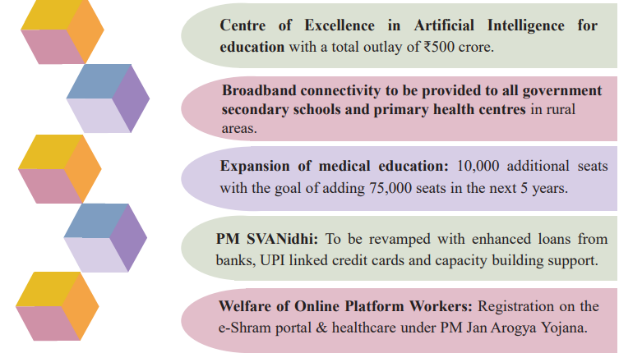
Investment in PEOPLE

Slide 25
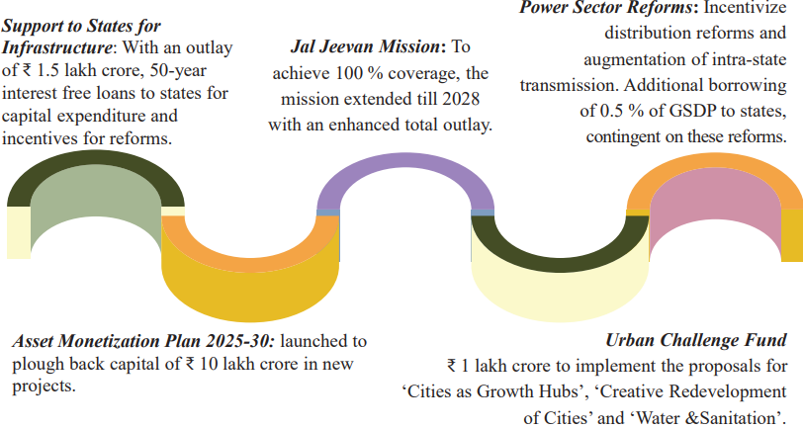
Investment in ECONOMY

Slide 26
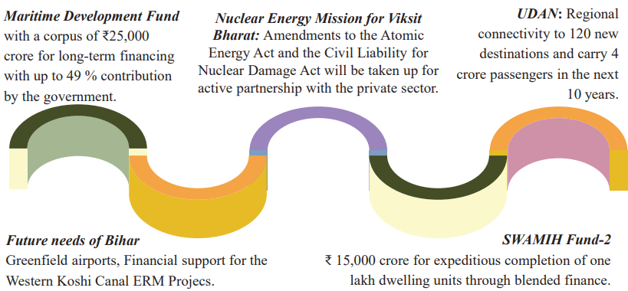
Investment in ECONOMY

Slide 27
Investment in ECONOMY
Asset Monetisation Plan – Earn money from Govt assets and invest in NIP (National Infrastructure pipeline)
Nuclear Energy Mission – Target = 100 GW (present only 6 gw), allow private players, boost Small Modular Reactors production
SWAMIH Fund – (Special Window for Affordable & Mid - Income Housing)

Slide 28
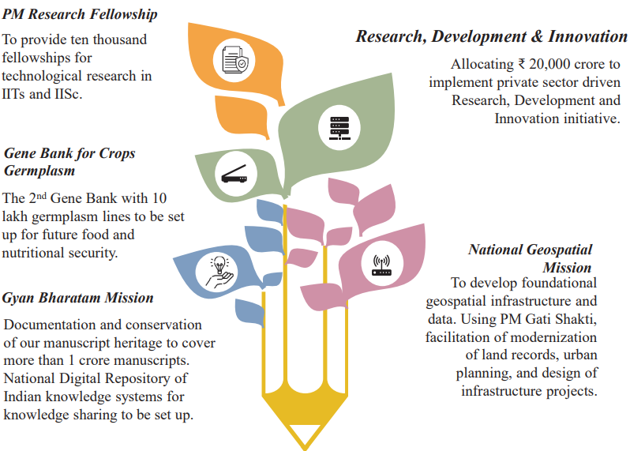
Investment in INNOVATION

Slide 29
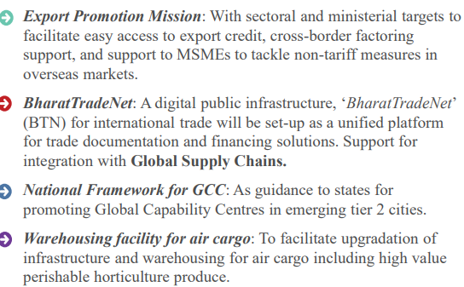
4thEngine of Development - EXPORTS

Slide 30
FUEL : REFORMS
Reforms in 3 spaces
Financial Sector Reforms
Regulatory Reforms &
Tax Reforms

Slide 31
Financial Sector Reforms
‘Grameen Credit Score’ framework to serve the credit needs of SHG members and people in rural areas. (SHG - No need for collateral upto 20 lakh loan)
NaBFID to set up a ‘Partial Credit Enhancement Facility’ for corporate bonds for infrastructure.
FDI limit for the insurance sector will be raised from 74 to 100 per cent (but for only those companies who invest 100 % of their premium collected back into India)

Slide 32
Credit Information Companies (CIC) Vs
Credit Rating Agencies (CRA)
CIC
CRA
RBI regulates them
They check the credit worthiness/ loan repayment capacity of “Individual Persons”
Rating is numerical scores. e.g. CIBIL Score 300-900.
Better the score → 1) Loan application will be passed faster. 2) You'll get loans at lower interest rate.
SEBI regulates them
They check the credit worthiness/ loan repayment capacity of “companies, governments, local bodies” etc.
Rating is alphabetical symbols e.g. Sovereign ratings AAA, AA, D- etc.
Better the score → 1) Loan application will be passed faster. 2) Companies will get loans at lower interest rate. 3) Increase investor’s confidence

Slide 33
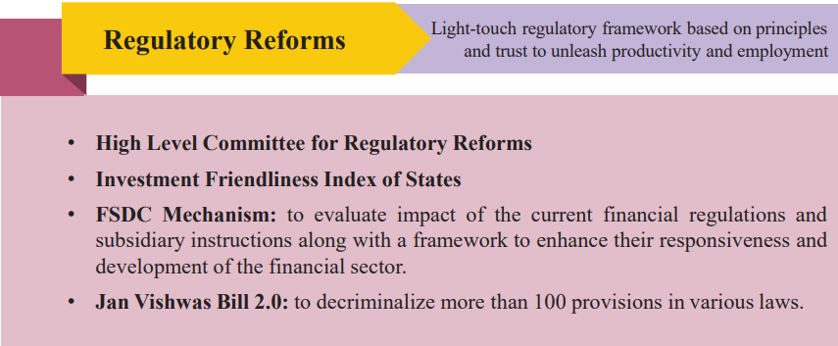
Regulatory Reforms

Slide 34
Tax Reforms
New Tax Regime changes – No Income tax upto 12 lakh taxable income – Revenue Forgone
Customs tariff – nil on 36 life saving drugs & 25 critical minerals
Rationalize customs cess
Rationalize TDS & TCS
Equalization levy / Google tax / Digital Service tax – Abolished – on online ad services & e-commerce platforms

Slide 35
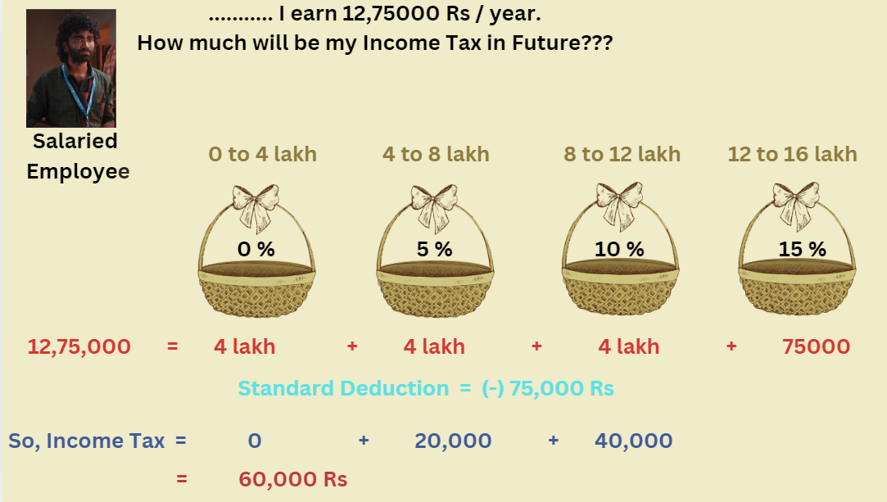
Income Tax Reforms

Slide 36
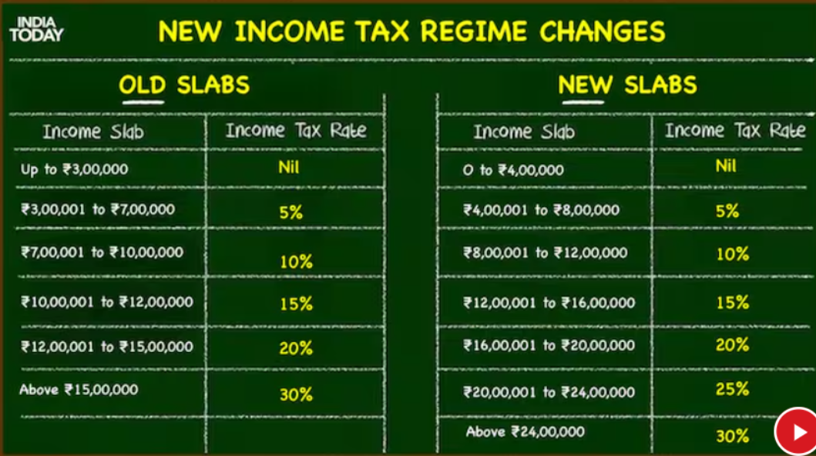

Slide 37
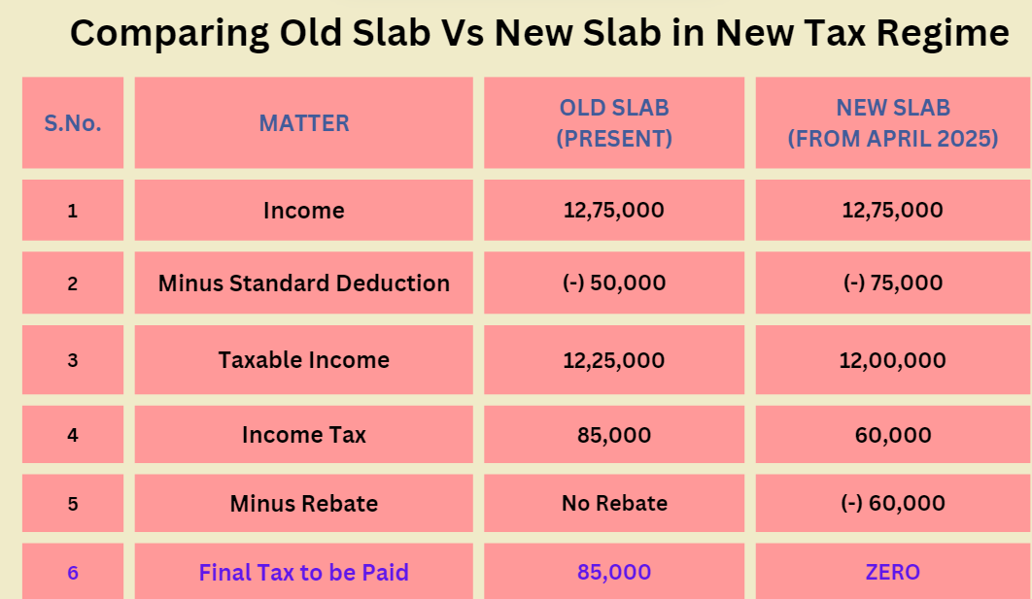

Slide 38

Customs duty reforms

Slide 39

Customs duty reforms

Slide 40
Cess & Surcharge
 | CESS | SURCHARGE
Levied on | All tax payers | Only on those earning > 1 Cr
Levied on | Indirect taxes (Exception – Health& Education cess levied on direct taxes) | Direct taxes (Exception – Social Welfare Surcharge levied on Customs tax collected on imports)
Collected & Deposited in | Consolidated Fund of India | Consolidated Fund of India
Rate | Fixed | Varies as per income bracket
Objective | For funding specific purposes like education, roads etc | No specific purpose (Exception – Social Welfare Surcharge). Only to tax rich individuals
Examples | Health Cess, Education cess, Road & Infrastructure cess, COVID cess etc | Income tax surcharge, Corporation tax surcharge , Social Welfare surcharge etc

Slide 41
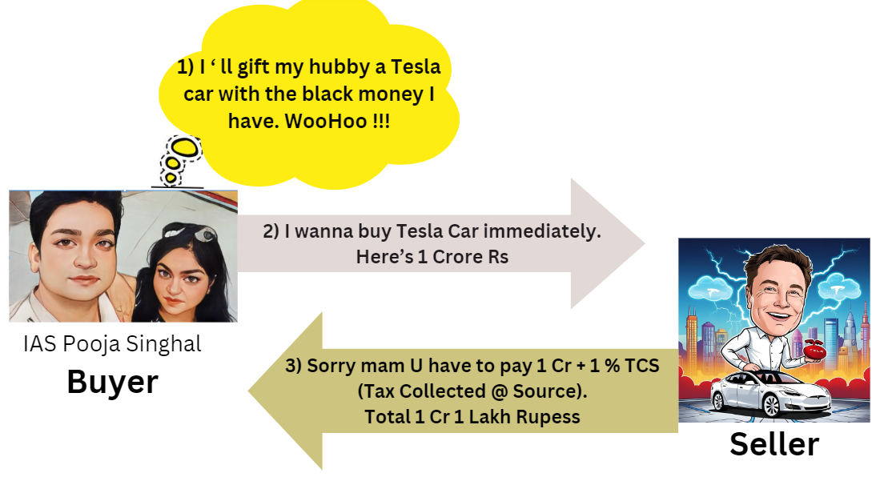
TCS (Tax Collected @ Source)

Slide 42
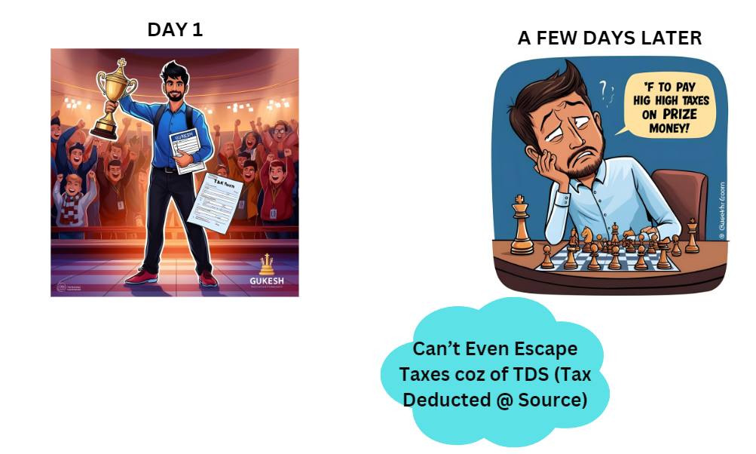
TDS (Tax Deducted @ Source)

Slide 43
Components of Budget
BUDGET
Revenue Budget
Revenue Receipt
Revenue Expenditure
Capital Budget
Capital Receipt
Capital Expenditure
Tax
Non Tax
Direct Tax
Indirect Tax
Debt creating
Non - Debt Creating

Slide 44
Revenue Receipts
Revenue Receipt
Tax
Direct Tax
Indirect Tax
Non Tax
Corporation Tax
MAT / AMT
Angel Tax
Others
Income Tax
Capital Gains Tax
GST
Equalization Levy
STT, CTT
Wealth Tax, Gift Tax, Estate Tax
Fines & Service charges
Interest receipts
Dividends from PSUs
Grants received
Excise tax
Customs Tax
VAT – State Govt
All except Agriculture
Agriculture Income Tax – State Govt
Professional Tax – collected by State Govt

Slide 45
Revenue Expenditure
(Expenditure other than that for creating Assets)
Revenue Expenditure
Plan
Central plans
Central assistance - Grants given to states
Non Plan
Interest Payment
Subsidies
Salaries & Pensions
Central Sector schemes
Central Sponsored Schemes

Slide 46
Capital Receipt
(⏫ liability / ⏬ Assets for the Govt)
Capital Receipt
Debt Creating (Loans)
From Domestic
From Foreign
Non Debt creating
PSU Disinvestment
Recovered Loan Principal Amount
Govt
Banks like WB, ADB etc
Strategic disinvestment
Disinvestment

Slide 47
Capital Expenditure (Capex) – For creating Assets
(⏬ liability / ⏫ Assets for the Govt)
Capital Expenditure
Plan
Central plan
Central Assistance – Giving loans to states
Non plan
Repaying back the Loan Principal Amount
Central sector schemes
Central Sponsored schemes
Capex for General Govt services

Slide 48
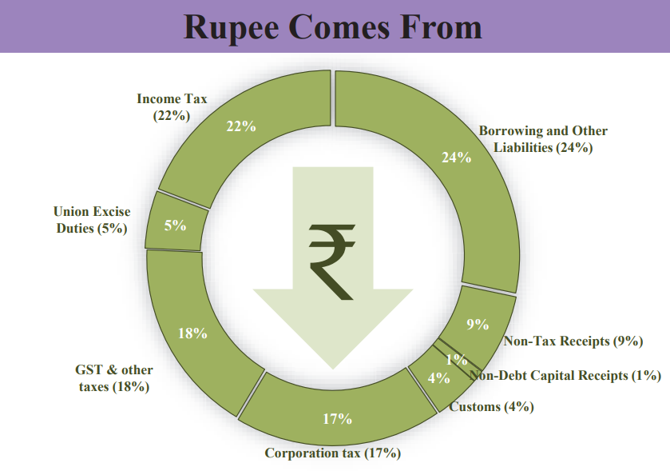

Slide 49
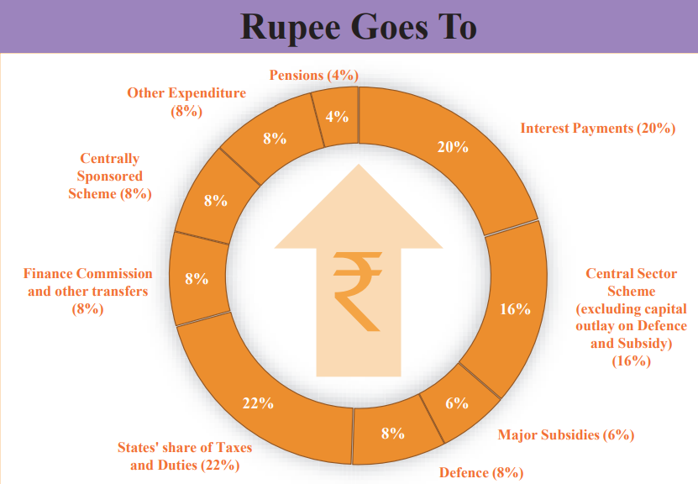

Slide 50
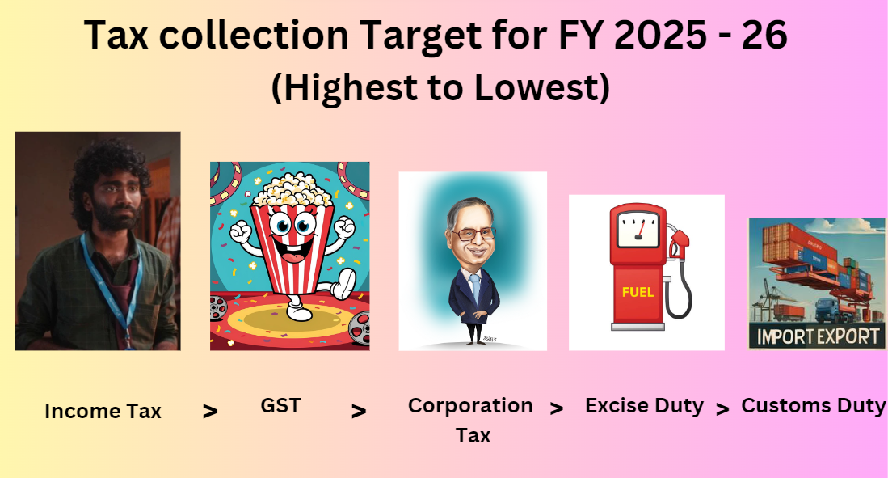
Tax collection in BE for FY25-26

Slide 51

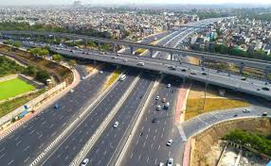
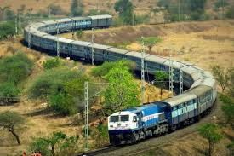
Ministry-wise Highest Allocation in Budget 2025 - 26
>
>

Slide 52
TYPES OF DEFICITS
Fiscal Deficit / Gross Fiscal Deficit
Primary Deficit
Revenue Deficit
Effective Revenue Deficit

Slide 53
Fiscal Deficit
Fiscal Deficit = Total expenditure (–) Total receipts excluding Borrowing
Fiscal Deficit = Total expenditure – (Revenue receipts + Non-debt creating capital receipts)
[since borrowing = Debt creating capital receipts]
This borrowing includes both internal borrowing [such as through Small Savings Scheme + through G-Secs subscribed by Banks / NBFCs + Borrowing from RBI] + External Borrowing
Therefore, Fiscal Deficit = Total borrowings = Internal Borrowing + External Borrowing
Example - If Fiscal Deficit in a year is 1 lakh Crore, then Govt has to borrow 1 lakh Crore
Fiscal Deficit is also called Gross Fiscal Deficit

Slide 54
Primary Deficit
Primary Deficit = Fiscal Deficit (–) Net Interest Liabilities
Net Interest Liabilities means interest to be paid by the govt on previous loans (–) interest to be received by the govt
This gives the real value of deficit in a year since the money borrowed for interest repayments are subtracted

Slide 55
Effective Revenue Deficit
Revenue deficit = Revenue expenditure (–) Revenue receipts
Effective Revenue Deficit = Revenue Deficit (–) Grants given to states for creation of capital assets
Effective Revenue Deficit gives a real value of Revenue Deficit in a year since Grants given to States by the centre used for formation of Capital Assets are subtracted.

Slide 56
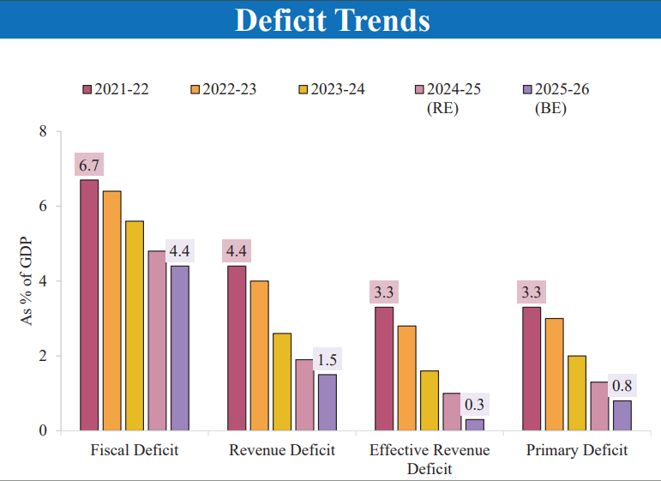

Slide 57
FRBM Act 2003
The Fiscal Responsibility and Budget Management (FRBM) Act of 2003 is aimed at improving the government’s fiscal management. It sets targets for reducing the gross fiscal deficit (GFD) and the government’s debt-to-GDP ratio, ensuring fiscal discipline, and enhancing transparency in budgeting.
The main features of this act (updated time and again) are
Central govt should reduce fiscal deficit to 4.5 % of GDP by 2025 – 26. Currently it is 4.8 %
State govts should reduce fiscal deficit to 3% + extra 0.5% for power sector reforms (= total 3.5% of state GDP / GSDP)
Debt to GDP ratio should be 60 % (40 % for centre & 20 % for states). Presently it is 83 % for both centre and state combined

Slide 58
Changes in FRBM Targets
This budget announced
Govt no longer need to follow a Fiscal Deficit target (since FD depends on a particular year’s economic cycle)
Only Debt to GDP ratio is enough to achieve. Central Govt target has been increased to 50 +/- 1 % by 2031 (currently it is 56%)

Slide 59
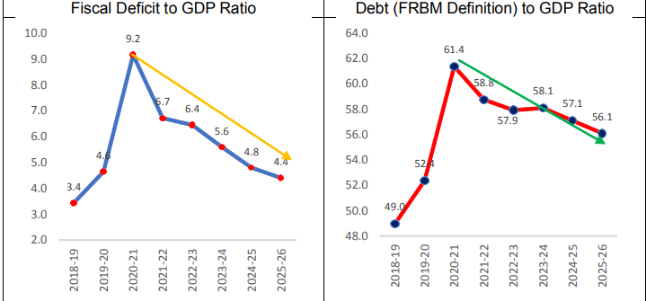
FISCAL GLIDE

Slide 60

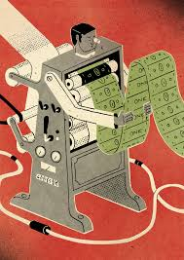

FINANCING THE DEFICIT
S. No. | Available Options | Problems associated with them
1 | Increasing Tax Rates | But Tax rates can’t be ⏫ beyond a point because it may force people to evade taxes / discourage them to work. (Laffer Curve)
2 | Printing More money by RBI (Also known as Monetisation of deficit) | But it is restricted by FRBM Act 2003 because it will result in hyperinflation
3 | Borrowing more money | Only viable option left. But if govt borrows more money today, the future generations will have to bear high tax burden (Ricardian equivalence) & Crowding out effect

Slide 61
Features of Govt Debt / Public Debt in India
Majority of Govt Debt in India is Internal (Only 5-6 % Debt is External), Rupee denominated with Fixed interest rate & Long term
Majority of Govt’s internal debt is marketable debt (Govt's dated securities (G-Sec) issued through auctions. Investor can easily resell it in secondary market)
Moreover, public debt for India has declined since 2003
India's "debt to GDP" ratio is lowest among following group of countries: 1) G20 2) OECD 3) BRICS

Slide 62


